Slide 1
Radio Programming Software
An Overview Presentation
A presentation for the Raytown Amateur Radio Club, Inc.
Version 1.01
Copyright © January 2019 Randal R. Schulze dba Hams in Space

Slide 2
All That Legal Stuff
This presentation is an overview on radio programming software which is available, including software from RT Systems of Broomfield, Colorado.
This presentation is based on user experience, and information publicly available from RT Systems and other sources. RT Systems has not participated in the creation of this presentation. Nothing in this presentation is an endorsement by Randal R. Schulze, Hams in Space, or by the Officers and Members of the Raytown Amateur Radio Club, Inc.
The information provided here are the opinions of the author, Randal R. Schulze. The audience is urged to continure their own research, and come to their own independent conclusions.
Thank You!

Slide 3
View From the Top
Automated Radio Programming has three major components:
The Radio to be Programmed
The Interface Cable
Computer Software
Each of these three components may have proprietary considerations which will be discussed.

Slide 4
The Radio to be Programmed
Many modern radios available from many manufacturers include the capability to have the channels and features configured via programming software. These include:
Fixed Stations (Such as Repeaters)
Fixed Stations are outside the scope of this presentation
Base Stations
Mobile Radios
Handheld HT Radios

Slide 5
The Radio to be Programmed
Every radio concerned will have unique or proprietary properties which are involved.
Cable Connection Point
Internal Firmware
Radio Controls
Knobs, Buttons, Switches
Power / Battery
There is no “One Size Fits All”
Every Manufacturer is Different.
Every Radio from an Individual Manufacturer May be Different.

Slide 6
The Interface Cable
Connectors Must Match Your Radio and Your Computer
One end connects to your radio
The other end connects to the computer.
Connector to computer is typically a USB Connection on a contemporary computer.
The connector may be a DB25 Serial Connector for an Older Computer.
The Correct Driver on your computer is important, and will be discussed later.

Slide 7
Computer Software
We’ll take a look at three popular options:
Baofeng
CHIRP
RT Systems
Important Comments will be made regarding software installation.
Wherever Possible, USB Drivers should be up to date before cables are connected.

Slide 8
Computer Software
Baofeng
Pros:
Free of Cost – Typically comes with the radio.
Interface Cable typically comes with the radio.
Cons:
Proprietary to Baofeng ONLY
Language Issues.
Some features written with Chinese caricatures.
Drivers often “counterfeit”.
Prolific Driver Issue
Use of Software Very Difficult

Slide 9
Computer Software
Baofeng
All and All, a great deal of time and effort was expended just to get the basic functions of this software to function properly.
I would “grade” this software as a “D-Minus”.
Had it not worked at all, this would be an “F”

Slide 10
Computer Software
CHIRP
Pros:
Free of Cost – Open Source and Available to All.
Non- Proprietary. Will work with most radios.
Large User Support Community on the Internet.
Cons:
A proprietary Interface Cable is still required.
Use of Software Somewhat Difficult
Not Many Features. Simple Cut & Paste is not available.

Slide 11
Computer Software
CHIRP
All and All, some time and effort was
I would “grade” this software as a “C”.
The lack of features and the ability to import / export files make this program lacking to my taste. It works. It just does not work as well as I would like.
You get what you pay for!”

Slide 12
Computer Software
RT Systems
Pros:
Robust software available for most program capable radios.
About 170 different radio models to date.
Very easy to install.
Very easy to use. Full of Features
If you can use MS Excel, you can use this software.
Can Save, Export, Import Files.
Capable of programming many radio features, not just channels.

Slide 13
Computer Software
RT Systems
Cons:
Very Proprietary
Each radio model requires its own software program.
It’s not Free, and it’s not inexpensive.
About $25 per Software License
About $30 for Interface Cable
Software/Cable Bundles $49

Slide 14
Computer Software
RT Systems
We’ll go into the software installation soon, but…
If you can get past the costs this package is easy to install, very easy to use, very easy to configure, and you can save, export, and import files.
I give this a Grade of B+ to an A depending on what model you are programming from.

Slide 15
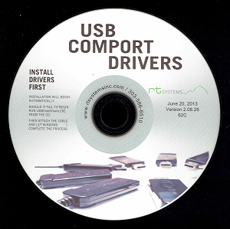
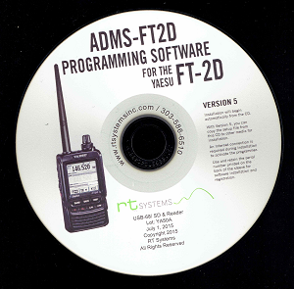
RT Systems Installation
IMPORTANT:
DO NOT plug in any interface cables until after you have installed your first iteration of RT Systems Software.
Many out of the box versions of RT Systems Software contains Two CD Disks

Slide 16
RT Systems Installation
Install the USB Comport Drivers First.
This installation of USB Drivers will not only guarantee that the RT Systems Interface Cable will function properly, it will help resolve any other USB Driver Issues you may have.

Slide 17
RT Systems Installation
Next, install the application software.
Once complete, it will offer an update. Take It!
You’re Done!

Slide 18
RT Systems Installation Notes
When entering your license key or serial number; Do not enter spaces, and it is not case sensitive.
While your key may contain Zeros, it likely will not contain the letter O.
While I have not had any issues installing the same package on more than one computer, I would not install my copy, (Bootleg) the software on anyone else's computer.

Slide 19
RT Systems Installation Notes
Typically, you will only need to install the USB Comports Driver the first time you install any RT Systems Software. You can go straight to the application software if you add another version.
Windows 10 may gripe that the application you’re installing is not compatible. Simply run the install in Combability Mode.

Slide 20
RT Systems Installation Notes
During the Update Phase, it may say something to the effect that the program may need to stop and restart one or more times. That’s alright. Just press ok until it says it’s done.
You can check and run update in the future if needed. If you have a valid software license, it is free of charge.

Slide 21
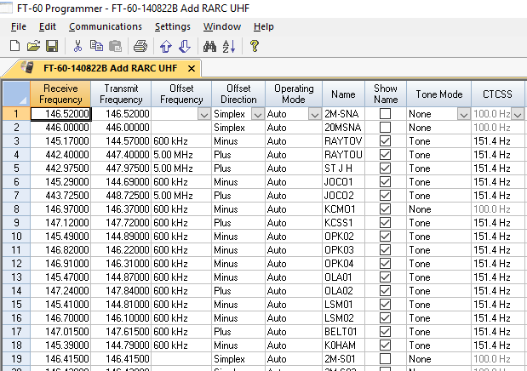
RT Systems ScreenShot
This is a partial screen shot of the RT Systems Program Screen for a Yaesu FT-60:

Slide 22
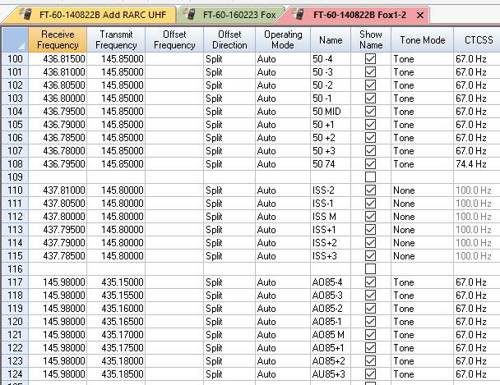
RT Systems ScreenShot
This is a partial screen shot of the RT Systems Program Screen of a Yaesu FT-60 for Satellite:

Slide 23
RT Systems Website
https://www.rtsystemsinc.com/
The website is not just a place to purchase the products, there is a wealth of information and videos regarding installation, use, tips, and more. This is a very good source of information.

Slide 24
Questions and Answers
Q & A

Slide 25
Thank You!
Randy Schulze KDØHKD Kansas City, Missouri
January 2019

