Slide 1
My SDR Journey
Pros, Cons, Experience, and Lessons Learned v1.01
Copyright © 2024, Randal R, Schulze dba Hams in Space
Vv1.01 01AUG24

Slide 2
Overview
Software Defined Radio, or SDR is a radio communication system where components that conventionally have been implemented in analog hardware (e.g. mixers, filters, amplifiers, modulators/demodulators, detectors, etc.) are instead implemented by means of software on a computer or embedded system. While the concept of SDR is not new, the rapidly evolving capabilities of digital electronics render practical many processes which were once only theoretically possible.

Slide 3
Overview
In most cases Software Defined Radio for Amateur Radio is used for receiving, although there are transceivers, with Flex Radio being one example.
For an expanded description of SDR, see the Wikipedia Article at: https://en.wikipedia.org/wiki/Software-defined_radio
Like many aspects of Amateur Radio, there are many different options, projects, and uses of SDR available to the HAM. My interests evolved to the implementation of a Panadaptor.

Slide 4
Overview
A Panadapter is short for Panoramic Adapter. The simple answer is that it allows us to see a panoramic display of the band our radio is tuned to... We can see every signal over the entire band.
For me, an SDR Panadaptor has added several new dimensions to my Amateur Radio Experience as it allows me to not simply hear a signal, it allows me to actually see a signal’s frequency, amplitude, strength, and bandwidth to name just a few of its attributes.

Slide 5
Overview
This presentation is an attempt to “scratch the surface” of the topic of SDR Radio, and perhaps allow some ideas for what you might want to do with SDR.
This is also to provide my experience, and lessons learned to aid you, in the event you wish to pursue an SDR Project as part of your Amateur Radio Journey.
73 and Have Fun!!

Slide 6
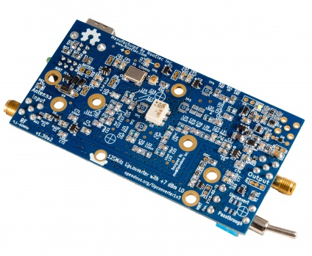
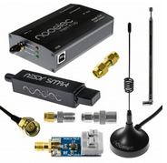
In the Beginning
RTL Dongles
VHF and Up
HF requires an “Up Converter”
Relatively Low Cost
Check Out:
https://www.nooelec.com

Slide 7
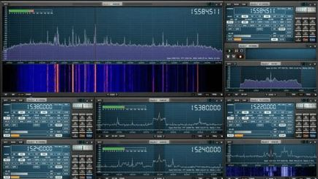
SDR Software
SDR# “SDR Sharp” (Free)
https://airspy.com/download/
HDSDR (Free)
http://www.hdsdr.de/
SDR++ (Free)
https://github.com/AlexandreRouma/SDRPlusPlus
SDRUno (Free)
http://www.sdrplay.com/windows.html

Slide 8
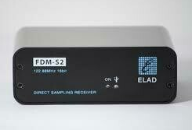
Advanced SDR
Dumb Luck!
A Grand Prize Win at 2015 Dayton Hamvention
ELAD FDM S2

Slide 9
ELAD FDM-S2
Italian made SDR Receiver
FDM-S2 is a direct sampling receiver based on 122.88MHz 16bit single channel AD converter covering HF and 6m. It offers the possibility to exploiting the under sampling mode covering FM Broadcasting Band and exploring part of the VHF Band (135-165MHz).
The prize came with other accessories, and at the time was valued at about $800 US. Today, the SDR Receiver retails for about $440 US.

Slide 10
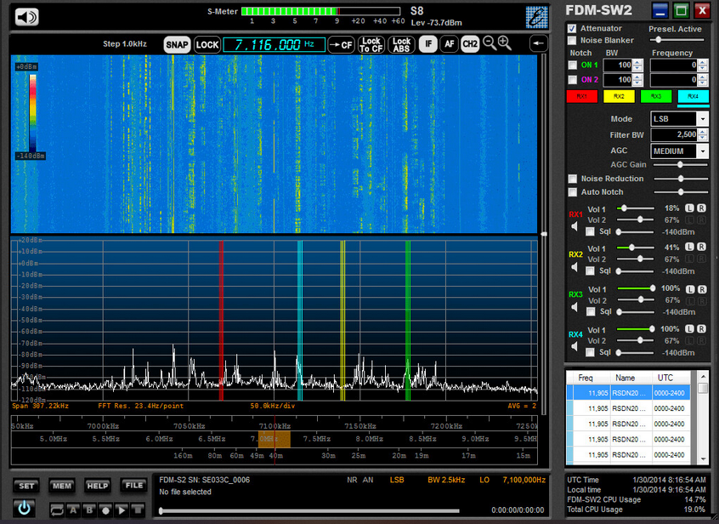
ELAD FDM-S2
This Receiver came with the FDM-SW2 Software

Slide 11
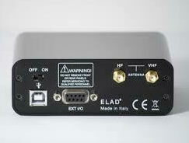
ELAD FDM-S2
Limitations of this Receiver:
Bandwidth: Frequency Range is focused in the area of the AM Broadcast Band, the HF Amateur Radio Bands, the VHF / FM Broadcast Bands, and the VHF-UHF Land Mobile and Amateur Radio Bands.
Antenna Port Options: The Receiver has one SMA port for HF and below, and one other SMA Antenna Port for VHF and Up. (Other receivers may have multiple antenna ports which will allow all received bands from any of the provided ports.)

Slide 12
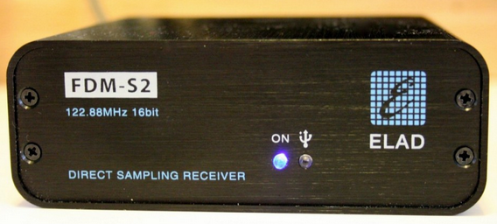
ELAD FDM-S2
Limitations of this Receiver:
Online documentation and support, while getting better is rather cryptic, which appears to be written in Italian and later translated to English. There are support groups, but I found it difficult to find answers for specific questions.
While this receiver is still offered for sale from ELAD as of July 2024, the limitations as stated above may be why the retail price for this receiver is significantly less than what was offered ten years ago.

Slide 13
Time Marches On!!!
SDRPlay Duo UK Made SDR Receiver
Manufacturer’s Description: The SDRplay RSPduo is a dual-tuner wideband full featured 14-bit SDR which almost covers the entire RF spectrum from 1 kHz to 2 GHz giving 10 MHz of spectrum visibility. Combined with the power of SDRuno software for Windows, you can simultaneously monitor two completely separate 2 MHz bands of spectrum anywhere between 1 kHz and 2 GHz. The RSPduo provides three software selectable antenna inputs, and clocking features ideally suited to industrial, scientific and educational applications. All it needs is a PC and an antenna to provide excellent communications receiver functionality. A documented API allows developers to create new demodulators or applications around the platform. SDR Uno Software is included for free.

Slide 14
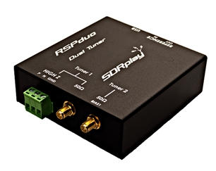
SDRPlayDUO
By pure coincidence, I came across this receiver ON SALE during the fall of 2023. The sale was for $50 off the retail price of $300 US.
https://www.hamradio.com/detail.cfm?pid=H0-016162
“This Receiver makes my ELAD SDR look like a Tinker Toy!”

Slide 15
SDRPlayDUO
It should be pointed out that the documentation for all SDRPlay Products is outstanding!
They also publish many, many Youtube Videos to demonstrate how to accomplish and use many of the options and features their receivers have to offer.

Slide 16
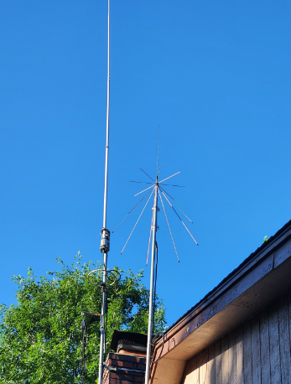
Antennas Used for my SDR Receiver:

Slide 17
Antennas
Comet CHA-250B Vertical HF Antenna
The Comet CHA-250B broadband vertical antenna will cover 75/80 meters through 6 meters.
I already own two of these. One is configured as the main HF Antenna for my Kenwood TS-2000 Transceiver. When I first obtained this antenna, I would refer to it as my “four-hundred-dollar dummy load.” Over time its good performance has impressed me, as I have made contacts all over the world.! In the case of my SDR Receiver, I set the second Comet up temporarily in my back yard as a receive only” antenna. More on that later when I talk about Special Considerations.

Slide 18
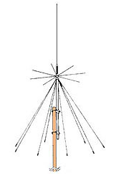
Antennas
Diamond D3000N Super Discone
The D3000N Super Discone Antenna is an ultra-wideband antenna covering amateur radio, commercial 2-way, cellular, air traffic control and various utility frequency bands. Bands: 25 MHz – 3000 MHz.
While you could transmit on this antenna, I doubt that you would want to as the transmit specifications suck! Its broadband receive characteristics on the other hand are impressive, and this is why I selected this antenna for my SDR Receiver.

Slide 19
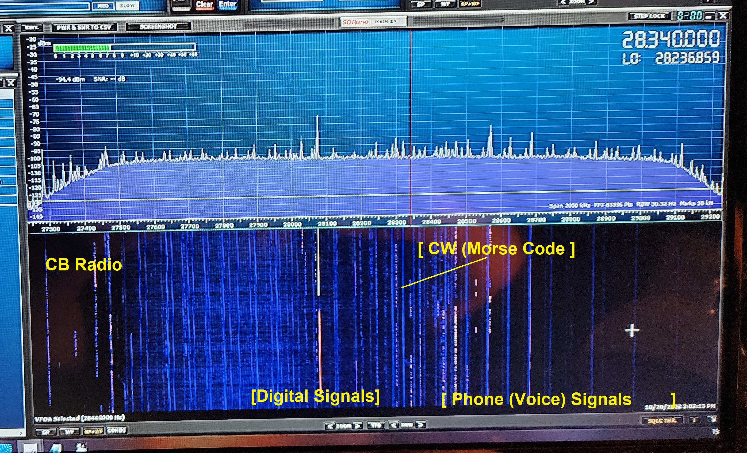
So Far, This Was My Initial SDR Setup
My timing was good in that the outstanding opening on 10m during the Fall of 2023 was just kicking off! Not only could I use the DX Clusters or simple tuning around the band, I could now actually see the signals across the 10m spectrum, tune to them and work them! One could say that the project was a success, and stop here as far as any further development and configuration goes. ..But why stop here?!

Slide 20
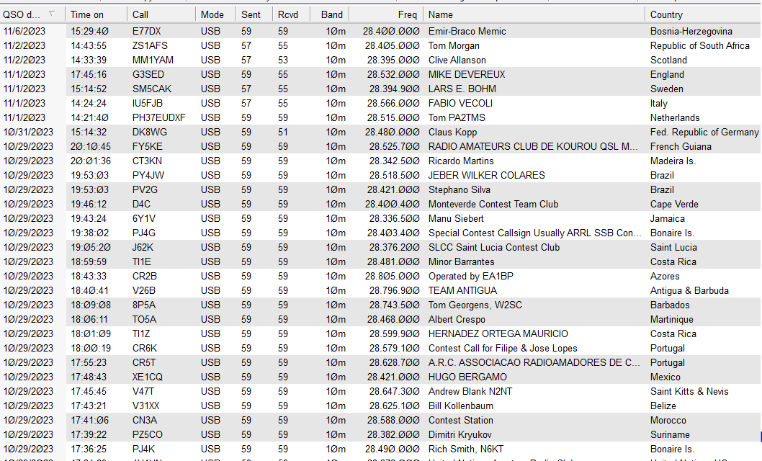
So Far, This Was My Initial SDR Setup

Slide 21
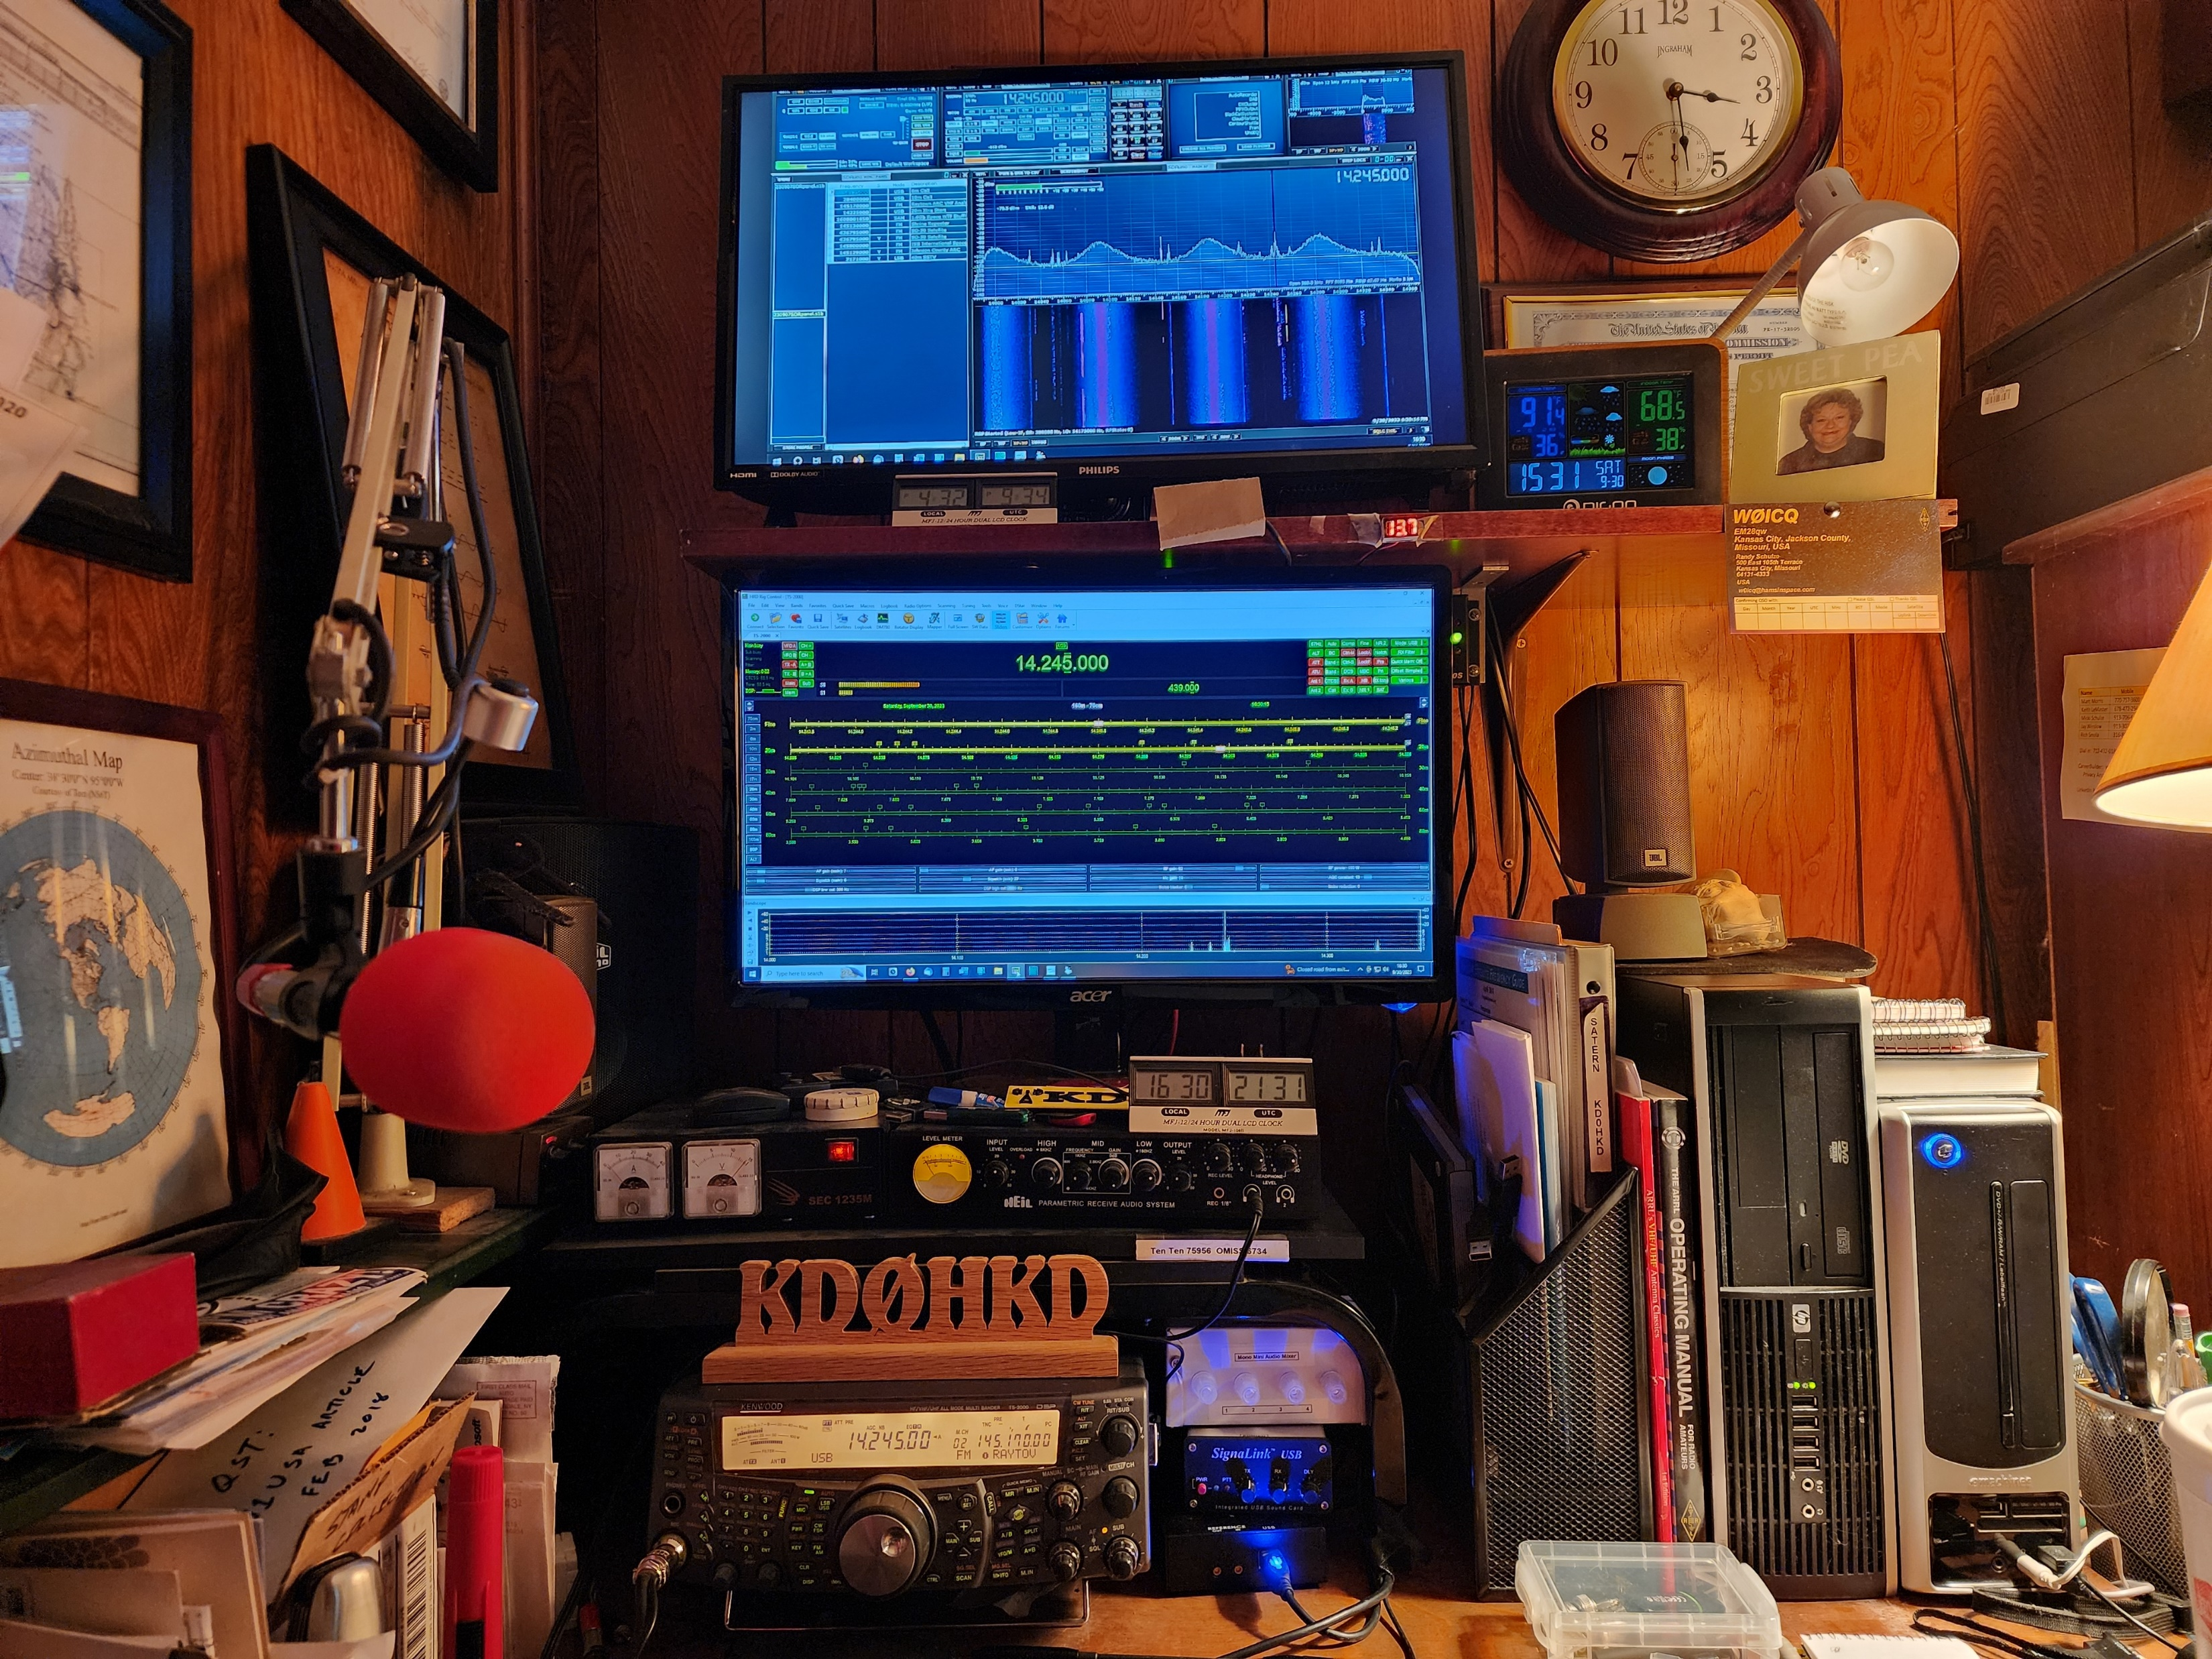
Customization & Improvements
During my review of SDRPlay’s excellent documentation, I learned that many of the hardware and software I already owned could be configured to work in conjunction with the SDR Uno software and SDRPlay receiver. Specifically, my Kenwood TS-2000 Transceiver and Ham Radio Deluxe (HRD) Radio Control Software Suite.

Slide 22
Customization & Improvements
Synchronization: There are two support articles in SDRPlay’s library. The first article I read for this procedure worked, but was rather clugy and clunky. Unexpectedly, a new article was published titled, ‘SDR Uno and HRD Revisited.’ This article streamlined the process, centering synchronization control on HRD. Again, you must follow the instructions closely, but the end result is fantastic.
There is some limitation that in order to tune your SDR receiver outside the Amateur Radio Bands, you must turn Ham Radio Deluxe off. HRD protects you from transmitting outside the Ham Bands.

Slide 23
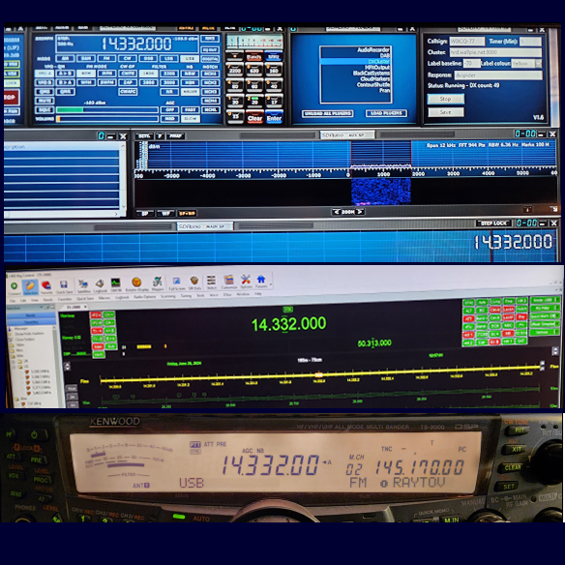
Customization & Improvements
Synchronization: Top – SDR Uno, Middle – Ham Radio Deluxe, Bottom – Kenwood TS-2000

Slide 24
Special Considerations
One topic the documentation is very clear about is warning NOT to overload your receiver from an RF perspective. This applies whether the receiver is turned on or turned off! If you’re a user who simply listens, but never transmits, this would not be an issue, but if you’re an Amateur Radio Operator who actually transmits more often than not, this is something you need to think about.
If I had lots of land, many antennas and lots of coax, I might place my SDR Receiver Antennas at one end of the farm, and my transmitting antennas at the other end. In this case, you’d probably be fine, but most of us who live in the city have all of our antennas on the roof of our house in town. In such circumstances you might be feeding your receiver antenna 100 watts of RF like drinking water from a fire hose! There are a couple of things you can do.

Slide 25
Here was my problem…

Slide 26
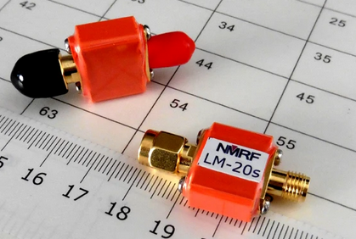
Special Considerations
Inline RF Limiters: First, I purchased two NMRF Brand, Model LM-20s RF Coaxial Limiters. These were installed on each of the two SMA antenna inputs of the receiver. This is intended to limit the amount of RF coming through the two antennas to the receiver. If you shop around, these can be found for as low as $20 each, but I’ve seen them as high as $50. There are less expensive online limiters out there for $1 or $2 bucks each, but I don’t trust them. You get what you pay for!

Slide 27
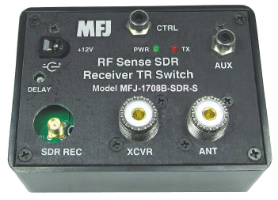
Special Considerations
RF Sensing Switch: Next, I learned that you can share the same antenna with your transceiver if you install an RF Sensing Switch. The SDRPlay documentation recommends the MFJ-1708. This switch works in two ways. One way, while in standby / receiving mode, it will share the antenna between the transceiver and the SDR receiver. If it senses any RF on the antenna, it will throw the switch to isolate the receiver. The other way, while in standby / receiving mode, it will share the antenna between the transceiver and the SDR receiver. When the Push to Talk, (PTT,) on the transceiver is activated, it will throw the switch to isolate the receiver. I used second option.

Slide 28
Special Considerations
RF Sensing Switch: I installed two of these. One between the Comet Antenna and the SDR with the side benefit of allowing me to use only one HF antenna, and the second RF switch between the discone antenna and the receiver. I now have double protection on both antennas; the RF Limiters and the RF Sensing Switches for my SDR. The bad news, is since the recent demise of MFJ Enterprises, the MFJ-1708 RF Sensing Switch is getting hard to find.

Slide 29
Having Fun!!!
The next few slides will display photos and screen shots without a lot of text.
Let’s enjoy and have fun!

Slide 30
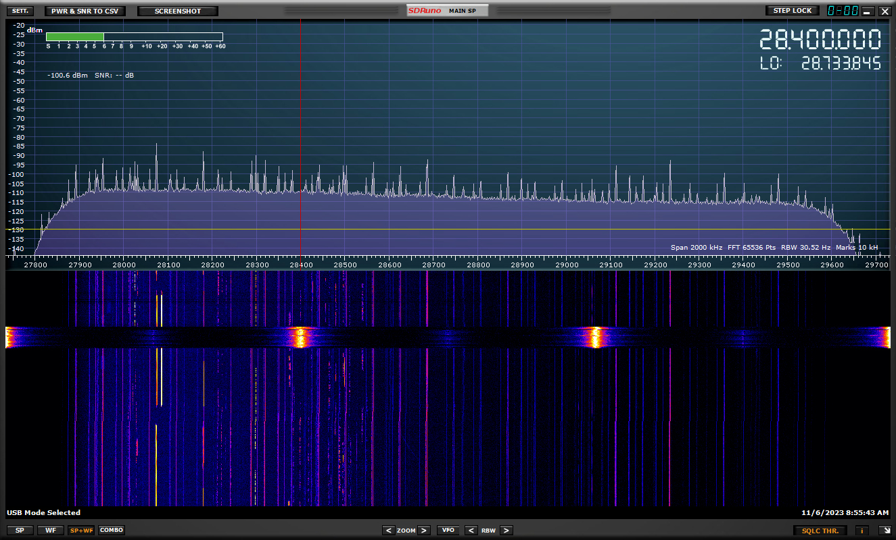
Having Fun!!!
Good Example of Harmonics

Slide 31
Having Fun!!!
Field Day 2024, 20m Band

Slide 32
Having Fun!!!
10m Opening, Fall 2023

Slide 33
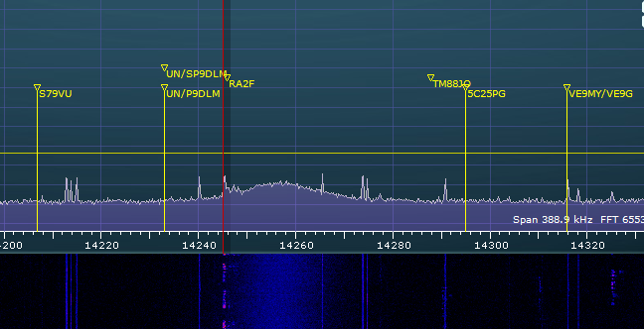
Having Fun!!!
DX Cluster Plug In

Slide 34
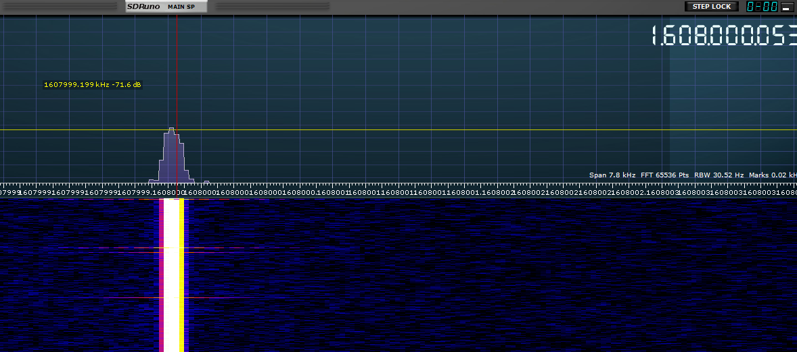
Having Fun!!!
1.6 GHz Satellite Signal
“As Seen on TV!”

Slide 35
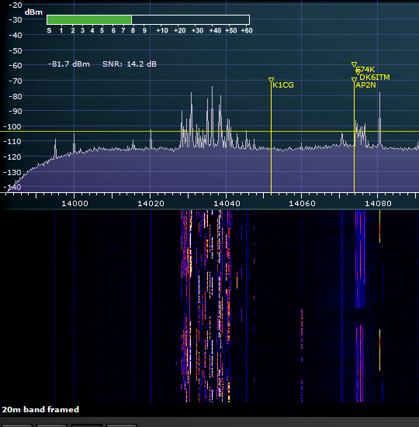
Having Fun!!!
20m CW Traffic

Slide 36
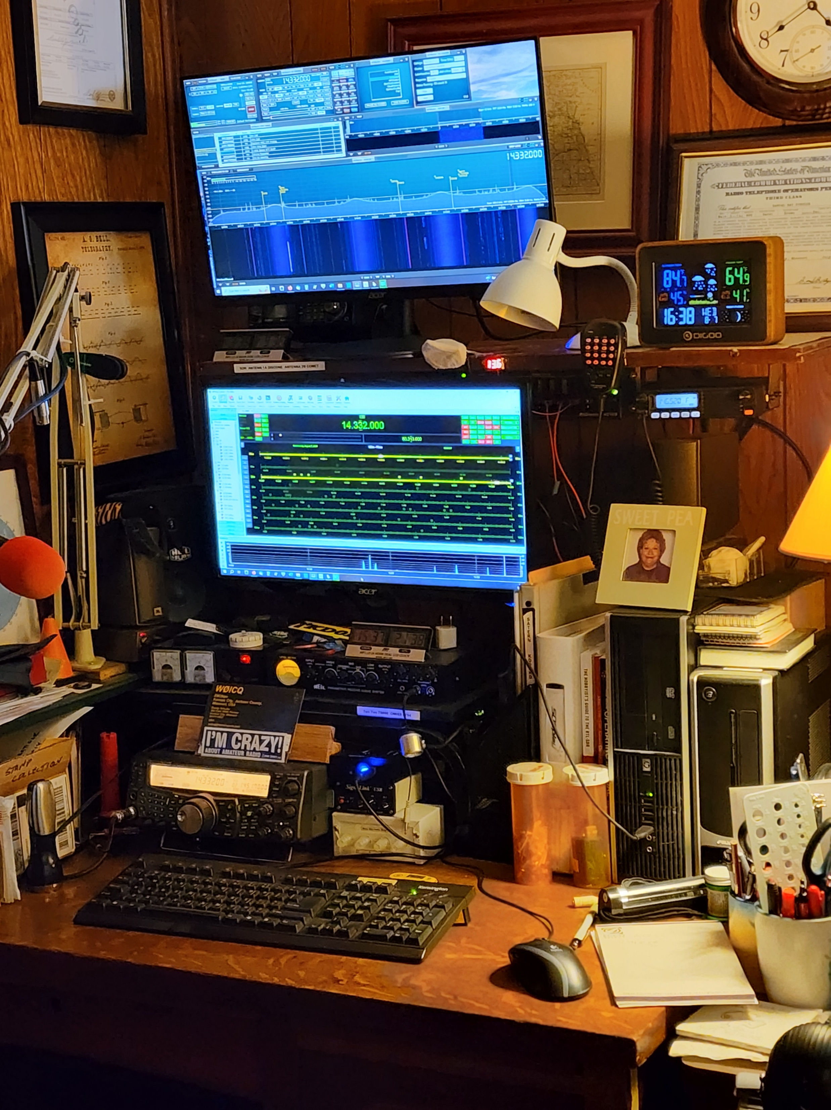
Having Fun!!!
The Whole Station

Slide 37
Special Thanks!
My Hat’s Off to these Fellow Hams who have helped me out with this project:
Phil Frame KF0LHD
My Wife no longer allows me to climb ladders and climb of the roof, etc. Phil came to the rescue, twice and even brought the ladder!
Jerry Chamberlin W0ZXH
Allowing me to call him at various times of the day or evening to help me figure out various road blocks, etc.

Slide 38
Q & A

Slide 39
A Hams in Space Production! Copyright © 2024 Randal R. Schulze dba Hams in Space
v1.01 01AUG24 My SDR Journey

